Slide 1
PROJECT ON Crop Yield Prediction and Efficient use of
Fertilizers
.
Presented by :
SIVAREDDY PULI(Y20IT096)
T.SRINIJ(Y20IT116)
D.RAJ KUMAR(L21IT131)
SK.NAYEEM(Y20IT102)
Guided By :
Dr.B.Hemanth Kumar

Slide 2
CONTENTS
1. PROBLEM STATEMENT
2. PROPOSED METHOD
3. BLOCK DIAGRAM
4. PROPOSED METHOD ALGORITHMS
5. RESULTS & DISCUSSIONS
6. CONCLUSION
7. REFERENCES

Slide 3
PROBLEM STATEMENT
The main aim is to Prediction of the crop yield using the efficient algorithms and suggest how much quantity of fertilizer should be used to get the proper yield for the crop

Slide 4
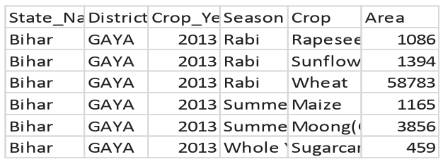
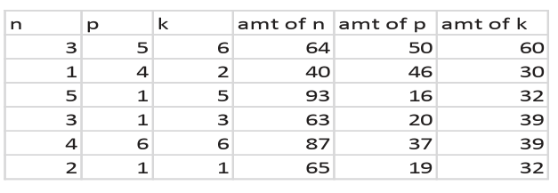
PROPOSED METHOD
Data Set Description :
Table 1:
Table 2:

Slide 5
PROPOSED METHOD
Metadata:
Here we convert all data into the numbers by useing label encoding techniques. Takeing example we have different crops in the data set we give each number to the each crop for rice giving as 1, red gram 2 etc..
Data Pre-processing:
Takeing the metadata we first clean the unwanted data like haveing null values in the label column. After this we processing with the outliers and missing values in the independent fields useing imputing technique and calucation q1, q2, q3 based on the values we treat the outliers. After this we check for the multicolliniarity in the data set if it have by useing vif we treat.
After this we devide the data set into trian and test data by giving 30:70 percent or 20:80.

Slide 6
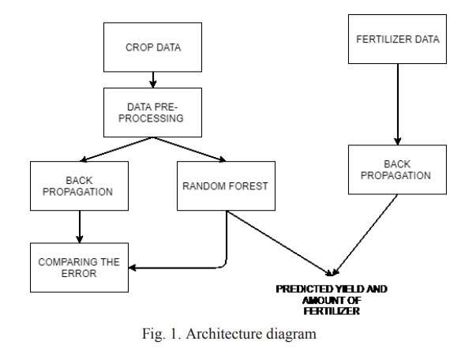
ARCHITECTURE

Slide 7
Random Forest Algo..
Random Forest Model Initialization:
1) Decide the number of trees (n_estimators) to be used in the forest.
2) Choose other hyperparameters such as maximum depth of the trees (max_depth),
minimum samples required to split an internal node (min_samples_split).
Bootstrap Sampling:
1) Randomly select samples from the training dataset with replacement . This creates
multiple subsets of the data for training each tree.
Prediction:
1) Aggregate predictions from all the trees in the forest to make the final prediction.
2) For regression, the final prediction can be the mean or median of the predictions from
individual trees.

Slide 8
Feature Importance:
1) Assess the importance of features in the model to understand which variables have
the most significant impact on the prediction.
Deployment:
1) Once satisfied with the model's performance, deploy it to make predictions on new,
unseen data.

Slide 9
Back Propagation
At first, to train the network we initialize the weights and bias.
Considering all attributes x from the dataset d compute the output for every unit in the network.
Then it back-propagates the error in the network For each output from the network as k, Calculate it’s error term ∂k
∂k = ⵔk(1-ⵔk)(t-ⵔk)
For each hidden unit h, calculate its error term ∂h
∂h = ⵔh(1-ⵔh)∑ Wkh∂k
K=outputs
Update each network weight
Wji = Wji+∆Wji
Where
∆Wji = ɳ ∂j xji

Slide 10
RESULTS & DISCUSSIONS
We use totally 3 datasets in this project Dataset.csv, Fertilizer_Prediction.csv, test.csv
got random 10-26-26
Test Record : [0.00000000e+00 1.27085266e-03 8.47235108e-01 4.23617554e-04
0.00000000e+00 5.31216413e-01] Production would be : 12708.404624015584 KGs
Yield would be : 1270.8404624015585 KGs/acre
Recommended Fertilizer : 10-26-26

Slide 11
got random 14-35-14
Test Record : [0.00000000e+00 1.49998538e-03 9.99990250e-01 4.99995125e-04
3.99996100e-03 9.99990250e-04]
Production would be : 2524.3205346918744 KGs
Yield would be : 252.43205346918745 KGs/acre
Recommended Fertilizer : 14-35-14
RMSE: 67.1382414509027;

Slide 12
CONCLUSION
Crop yield prediction and efficient use of the fertilizer issuccessfully predicted and also found the efficient algorithmrom both the algorithm and obtained the most efficient output of the yield.
In future developing the web application based onthis ideology and make the user use this easily and help theuser to understand the yield of the crop, he is going to crop in that season.

Slide 13
REFERENCES
Niketa Gandhi et al ," Rice Crop Yield Forecasting of Tropical Wet and Dry Climatic Zone of India Using Data Mining Techniques",IEEE International Conference on Advances in Computer Applications (ICACA) , 2016.
K.E. Eswari. L.Vinitha. " Crop Yield Prediction in Tamil Nadu Using Baysian Network ", International Journal of Intellectual Advancements and Research in Engineering Computations, Volume-6,Issue-2,ISSN: 2348-2079.
Shruti Mishra, Priyanka Paygude, Snehal Chaudhary, Sonali Idate “Use of Data Mining in Crop Yield Prediction” IEEE Xplore Compliant - Part Number:CFP18J06-ART, ISBN:978-1-5386-0807-4; DVD PartNumber: CFP18J06DVD , ISBN:978-1-5386-0806-7.

Slide 14
REFERENCES
Anna Chlingaryana, Salah Sukkarieha, Brett Whelanb ― Machine learning approaches for crop yield prediction and nitrogen status estimation in precision agriculture: A review , Computers and Electronics in Agriculture 151 (2018) 61–69,Elisver,2018.
Machine Learning by Tom M. Mitchell, ISBN: 0070428077
Pooja M C et al, ―Implementation of Crop Yield Forecasting Using Data Mining , International Research Journal of Engineering and Technology (IRJET),2018,p-ISSN: 2395-0072

Slide 15
THANK YOU

